Slide 1
How do we train a computer to make decisions?
Unit 3, Module 3.3

Slide 2
Topic Outline
Activities
Unplugged Activity - Fish Classifier - Poisonous Fish example - 20 mins
Takeaway - Experience finding patterns in data. One way is to help computers learn to make decisions is to write a set of rules/algorithms another isto show them examples
(Fish Classifier). - Students determine a rule.
Outcome - come up with a rule that distinguishes between the two classes.
Resources:
Deck of cards Fish cards
Chart - Prediction - Prediction - Actual
Class A & Class B - Actual
Students need to come up with a
Facilitation guide: Give the teacher a set of categories - Poisonous, live in reefs/caves, eat seaweed. Key use categories/concepts that they can’t bring their prior knowledge to bear - gives them the sense of what a statistical NN is doing
Easy - color or body shape
green fish like shrimp
Blue fish live in caves
Medium - nuanced shapes
Hard - conjunction of features - blue fish with triangular bodies like pizza
which jump out of the water
Crescent shaped tails
Teacher knows the rules - they will put it in the right class.
Computer Activity Options: Intro to machine learning for kids - Fish Classifier
  They can do this on their own
  Then give them a pre-built data set.
Code.org AI lab - upload a tabular dataset - Doesn’t show a decision tree because it doesn’t have a decision tree
Learning Decision Trees
(1) Unplugged: finding patterns in data. Figure out the rule for poisonous fish.
(2) Introduce the fish feature set.
(3) Learn how to define features and instances in ML4K.
(4) Load a pre-supplied project with full fish dataset.
(5) Train a poisonous fish classifier and examine the decision tree.
(Students use computers to create a decision tree)
(System has a small number of classes but a lot of instances)

Slide 3
From Big Idea 3: Learning Algorithms Operate On Reasoners
Learning new behaviors results from changes the learning algorithm makes to the internal representations (parameters) of a reasoner, such as a decision tree or a neural network.
The learning algorithm and the reasoning algorithm are different things.
We could build a classifier using a decision tree as the reasoning algorithm. What if we want to learn this decision tree?
There are several learning algorithms for learning decision trees. They do this by adding one node at a time.

Slide 4
What does it feel like to be a machine learning algorithm?
We will look at two different decision tree learning algorithms.
Let’s learn to classify fish…
Notes:
Take Away - We are asking a computer to design the tree to learn a concept that it has no notion of. So it doesn’t know what features are relevant or what values of those features are important. It has to figure it out from the training data.
So that we are not cheating we will pick a concept we also don’t know of in advance. We will learn along with the computer. That way we will know what it feels like to learn the way that the computer learns.

Slide 5
A Fishy Feature Space

Slide 6


















Fish from Code.org’s AI for Oceans

Slide 7

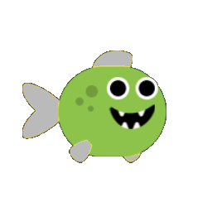
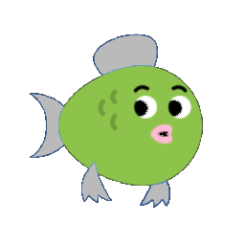


Body Types
1=circular 2=oval 3=egg 4=wedge 5=triangle
Notes:
Teacher Note - Features are not binary. Notice for the body type we have 5.

Slide 8
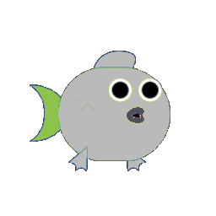


Tail Fin Types
1=crescent 2=heart 3=hanger

Slide 9

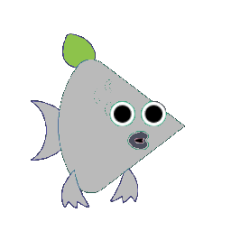
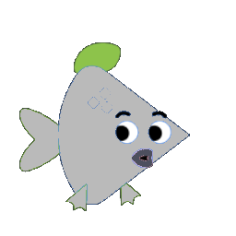
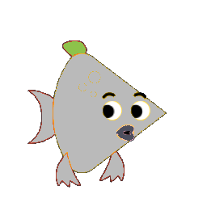
Dorsal Fin Types
1=lens 2=leaf 3=swept_forward 4=swept_back

Slide 10

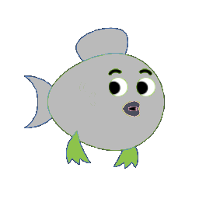

Pectoral Fin Types
1=sharp_points 2=curved_points 3=smooth

Slide 11
Body and Fin Colors
1=Red
2=Pink
3=Yellow
4=Orange
5=Lime
6=Forest
7=Blue
8=Purple

Slide 12
Fishy Feature Vectors
Body Type | Body Color | Tail Fin | Dorsal Fin | Pectoral Fins | Fin Color
1 | 4 | 1 | 1 | 1 | 5
5 | 3 | 3 | 2 | 2 | 2
2 | 1 | 2 | 1 | 3 | 6

Slide 13
First Learning Algorithm
For this algorithm we’ll assume the desired decision tree has only one node.
Generate all possible decision trees that could account for the data.
We’ll express each decision tree as a “rule” that tests one feature.
As new data come in, eliminate any decision trees that disagree with the data.
Keep going until only one decision tree is left.

Slide 14

Which fish live on reefs?
Possible decision rules:
body color = orange ⇒ non-reef
body color = blue ⇒ reef
body type = circular ⇒ non-reef
body type = egg ⇒ reef
tail fin = crescent ⇒ non-reef
tail fin = hanger ⇒ reef
dorsal fin = lens ⇒ non-reef
dorsal fin = swept back ⇒ reef
fin color = lime ⇒ non-reef
fin color = orange ⇒ reef
Non-reef:
Reef:
body color = orange?
potential decision tree
yes
no
non-reef
reef
Notes:
REVISE THIS
Teacher Note - Here are two fish note that we can’t tell by just looking at the fish which is a reef dweller. But the training data will tell us. We are relying on the labels from the training data to tell us which fish is a reef dweller.
Look at the top right corner - we are listing all the feature where these two fish differ.
We will pick our first feature on the list and test that feature (see decision tree)
We are trying to come up with an explanation for the training data. We are trying to come up with a rule …Since we have so little data so far .. some of these will drop out as we see more data.
We have four pairs that Each one of these pair is a different way of using the features
If we choose the first feature, is it orange we conclude not reef
Anything other than orange is a reef dweller
If we choose the second feature
Take away - Note the pairs are not expressing the same rules. They are expressing alternative rules.
The two elements in each pair will produce different predictions for some fish.
There are 8 different rules that we are looking at.
Any rule could be our potential decision tree -

Slide 15
Which fish live on reefs?
Possible decision rules:
body color = orange ⇒ non-reef
body color = blue ⇒ reef
body type = circular ⇒ non-reef
body type = egg ⇒ reef
tail fin = crescent ⇒ non-reef
tail fin = hanger ⇒ reef
dorsal fin = lens ⇒ non-reef
dorsal fin = swept back ⇒ reef
fin color = lime ⇒ non-reef
fin color = orange ⇒ reef
Non-reef:
Reef:
Notes:
Note - fix the table to show that these have been ruled out. We have eliminated half of the candidate rules because they produce the wrong answer for half of the examples.
We still don’t know what the correct rule is.
There is not enough information to select among the candidates.

Slide 16
Which fish live on reefs?
Possible decision rules:
body color = orange ⇒ non-reef
body color = blue ⇒ reef
body type = circular ⇒ non-reef
body type = egg ⇒ reef
tail fin = crescent ⇒ non-reef
tail fin = hanger ⇒ reef
dorsal fin = lens ⇒ non-reef
dorsal fin = swept back ⇒ reef
fin color = lime ⇒ non-reef
fin color = orange ⇒ reef
Non-reef:
Reef:
Notes:
It is possible for a training example to not tell you anything that you didn’t a;ready know

Slide 17
Which fish live on reefs?
Non-reef:
Possible decision rules:
body color = orange ⇒ non-reef
body color = blue ⇒ reef
body type = circular ⇒ non-reef
body type = egg ⇒ reef
tail fin = crescent ⇒ non-reef
tail fin = hanger ⇒ reef
dorsal fin = lens ⇒ non-reef
dorsal fin = swept back ⇒ reef
fin color = lime ⇒ non-reef
fin color = orange ⇒ reef
Reef:

Slide 18
Which fish live on reefs?
Non-reef:
Possible decision rules:
body color = orange ⇒ non-reef
body color = blue ⇒ reef
body type = circular ⇒ non-reef
body type = egg ⇒ reef
tail fin = crescent ⇒ non-reef
tail fin = hanger ⇒ reef
dorsal fin = lens ⇒ non-reef
dorsal fin = swept back ⇒ reef
fin color = lime ⇒ non-reef
fin color = orange ⇒ reef
Reef:
Notes:
As we see more examples we can have greater confidence that we have the right rule.

Slide 19
Which fish live on reefs?
Non-reef:
Reef:
Rule: body type = egg ⇒ reef

Slide 20
Result of the learning algorithm: a decision tree classifier
body type = egg?
yes
no
reef
non-reef

Slide 21

Using the learned classifier to make new predictions
Test Data Prediction
body type = egg?
yes
no
?
reef
non-reef
?
Notes:
We learned this tree. Let’s apply it to a new data. We will use it to make predictions about the class data.
We are testing our classifier. We want to see what prediction it makes.

Slide 22
Using the learned classifier to make new predictions
Test Data Prediction
body type = egg?
yes
no
Reef
reef
non-reef
Non-reef
Notes:
We learned this tree. Let’s apply it to a new data. We will use it to make predictions about the class data.
We are testing our classifier. We want to see what prediction it makes.

Slide 23
Let’s Try A Different Algorithm
This algorithm starts with all the training examples at the root node and repeatedly “splits” each node until all examples in the node are in the same class.
Real-world decision-tree learning algorithms work this way.
Notes:
This is different than we are doing pasta land where we knew everything in advance and we were doing splitting.
We are using an incremental algorithm.
The real algorithm would look at all the rules and choose the best splits.
So we are withholding
It looks at every possible feature and tries to figure out which one gives you the best split.
The split may not be perfect.
Split the data into two pieces but the data is still classified incorrectly.
Can I split this node. I want to split it so that I get perfect classification for both branches.
We are splitting until all the nodes are classified correctly.
In pastaland we split node had a single instance.
But in the general case, we only need to split until we have no errors.
In the poisonous example, we don’t have just one
We are considering alternative rules - we are graying out rules.
Connect this concept - we can’t make the predictions with small datasets
Solve the poisonous fish with splits.
Learn how to do the decision trees
Need a slide on with the splits

Slide 24



Which fish are poisonous?
Safe:
Poisonous:
Notes:
Teacher note: This is a new problem. There is no one feature that will tell us poisonous vs non-poisonous.
We will show you how to use a ML tool to solve a problem that you couldn’t sove on their own.

Slide 25
Pick A Feature To Start Your Decision Tree
Safe
?
Poisonous

Slide 26
Let’s Try The Dorsal Fin Shape
Safe
Dorsal Fin = Lens
Poisonous

Slide 27
Split The Examples Based on Dorsal Fin Shape = Lens
Dorsal Fin = Lens
Safe
Safe
True
False
Poisonous
Poisonous

Slide 28
Split Again, Based on Pectoral Fin Shape
Dorsal Fin = Lens
Safe
True
False
Pectoral Fin = Curved
True
False
Poisonous
Poisonous
Safe

Slide 29
Split Again, Based on Body Shape
Dorsal Fin = Lens
True
False
Pectoral Fin = Curved
Body Shape = Egg
True
False
True
False
Poisonous
Safe
Safe
Poisonous

Slide 30
Is This The Best We Can Do?
Try making your own decision tree classifier for poisonous fish.
  Choosing different feature tests may lead to a simpler tree, or a more complex one.
What about asking the computer to create a decision tree for us?
  We can use the “Machine Learning for Kids” web site for that.

Slide 31
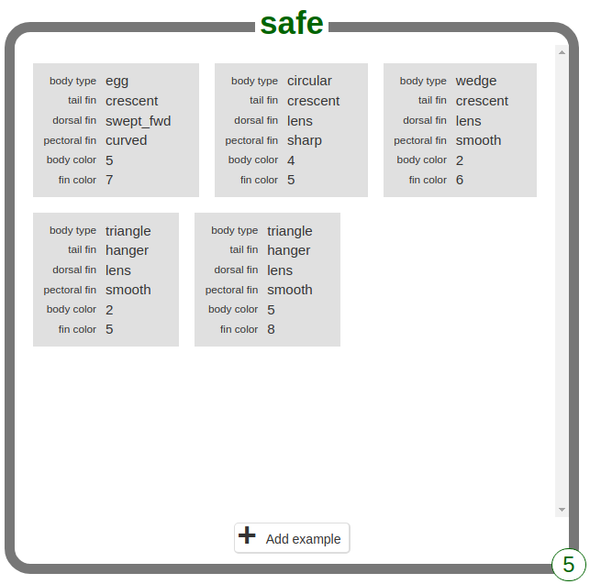
Using Machine Learning for Kids
https://machinelearningforkids.co.uk
Link to fish demo video
Notes:
To do we need to create the data set.
Fix the typos
Fix the feature order
Fix the colors codes
MLFK - requires 5 examples of each class

Slide 32
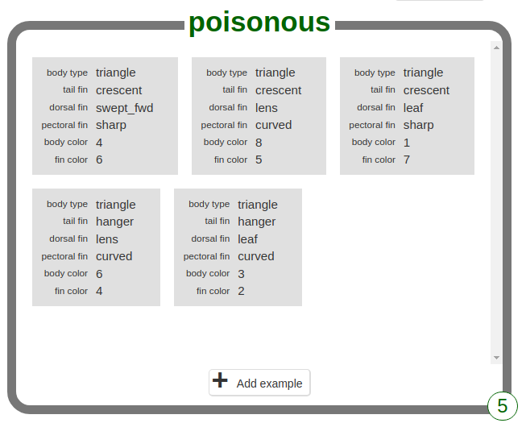
Using Machine Learning for Kids
Link to fish demo video
Notes:
To do we need to create the data set.
Fix the typos
Fix the feature order
Fix the colors codes
MLFK - requires 5 examples of each class

Slide 33
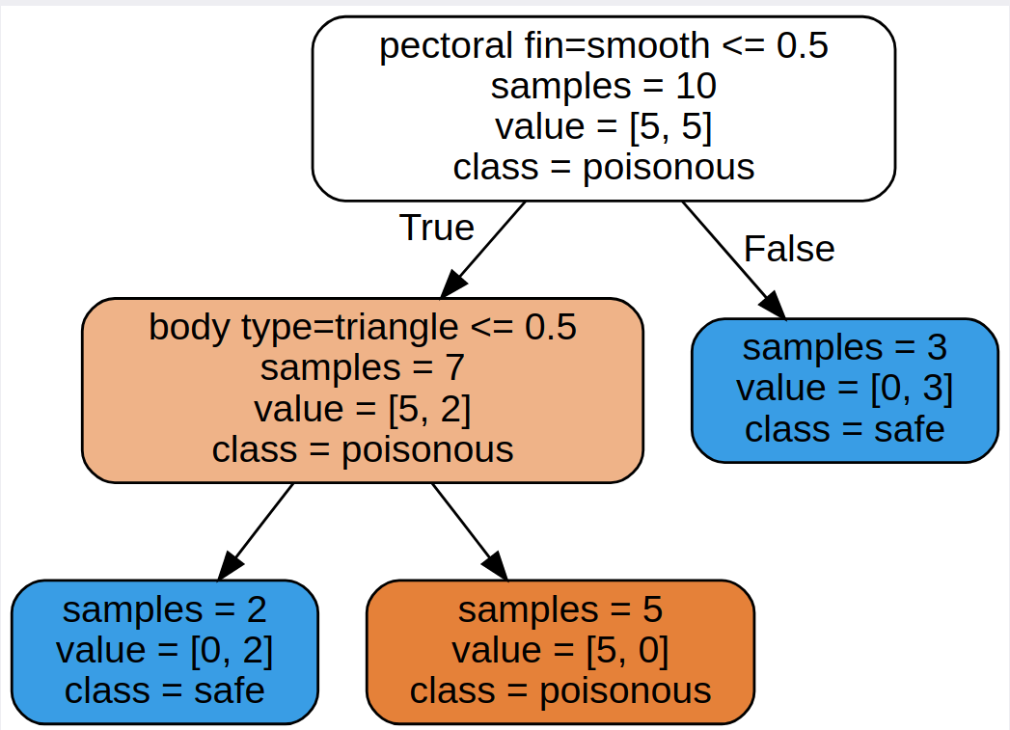
Computer-generated decision tree: what does this mean?
Notes:
After we train the model, we will get a decision tree
This is running using the splitting process
Value = [5,5] => 5 fish in the poisonous and 5 in the safe class
Every node needs to pick a class. Even if it is a terrible assignment.
The deep blue node labeled safe because all the samples are in the safe class.
Notice that only 5 of the 6 samples are poisonous.
Why is the root node white? It is getting have of the samples wrong. It is white because it is halfway between blue and orange.

Slide 34
Decision tree in our notation
Pectoral fins smooth?
no
yes
Body type triangle?
safe
no
yes
safe
poisonous
Notes:
Teacher note: this is a redrawn tree in our tree notation.

Slide 35
Computer-generated decision tree
Split on pectoral fin shape
Start with 10 fish
5 are poisonous, 5 are safe
Classify these samples as poisonous (only 50% accurate)
White background: neutral color because 50% of the samples are poisonous and 50% are safe
“pectoral fin = smooth” is 1 if true, or 0 if false.
Reverse Logic:
“pectoral fin = smooth <= 0.5” is true if the fins are NOT smooth, false if they ARE smooth.
So a sample will be assigned to the True branch if the pectoral fins are NOT smooth.
It will be assigned to the False branch if the pectoral fins ARE smooth.
Notes:
After we train the model, we will get a decision tree
This is running using the splitting process
Value = [5,5] => 5 fish in the poisonous and 5 in the safe class
Every node needs to pick a class. Even if it is a terrible assignment.
The deep blue node labeled safe because all the samples are in the safe class.
Notice that only 5 of the 6 samples are poisonous.
Why is the root node white? It is getting have of the samples wrong. It is white because it is halfway between blue and orange.

Slide 36
Computer-generated decision tree
Split on pectoral fin shape
Start with 10 fish
5 are poisonous, 5 are safe
Classify these samples as poisonous (only 50% accurate)
Split on body type
This node has 3 fish with smooth pectoral fins.
This node has 7 fish with non-smooth pectoral fins.
0 are poisonous, 3 are safe
5 are poisonous, 2 are safe
Dark blue: 100% “safe”
Light orange: 71% “poisonous”
All one class: no split needed
Notes:
After we train the model, we will get a decision tree
This is running using the splitting process
Value = [5,5] => 5 fish in the poisonous and 5 in the safe class
Every node needs to pick a class. Even if it is a terrible assignment.
The deep blue node labeled safe because all the samples are in the safe class.
Notice that only 5 of the 6 samples are poisonous.
Why is the root node white? It is getting have of the samples wrong. It is white because it is halfway between blue and orange.

Slide 37
Computer-generated decision tree
Split on pectoral fin shape
Start with 10 fish
5 are poisonous, 5 are safe
Classify these samples as poisonous (only 50% accurate)
Split on body type
This node has 3 fish with smooth pectoral fins.
This node has 7 fish with non-smooth pectoral fins.
0 are poisonous, 3 are safe
5 are poisonous, 2 are safe
Dark blue: 100% “safe”
Light orange: 71% “poisonous”
All one class: no split needed
This node has 2 fish with non-triangular bodies.
This node has 5 fish with triangular bodies
0 poisonous; 2 safe
5 are poisonous; 0 are safe
Dark blue: 100% “safe”
Dark orange: 100% “poisonous”
Notes:
After we train the model, we will get a decision tree
This is running using the splitting process
Value = [5,5] => 5 fish in the poisonous and 5 in the safe class
Every node needs to pick a class. Even if it is a terrible assignment.
The deep blue node labeled safe because all the samples are in the safe class.
Notice that only 5 of the 6 samples are poisonous.
Why is the root node white? It is getting have of the samples wrong. It is white because it is halfway between blue and orange.

Slide 38
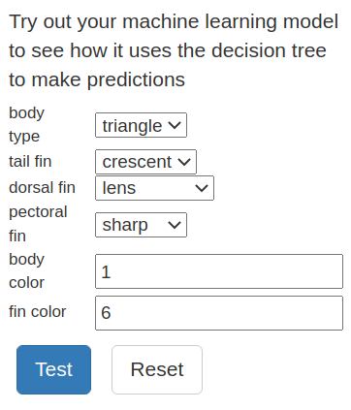
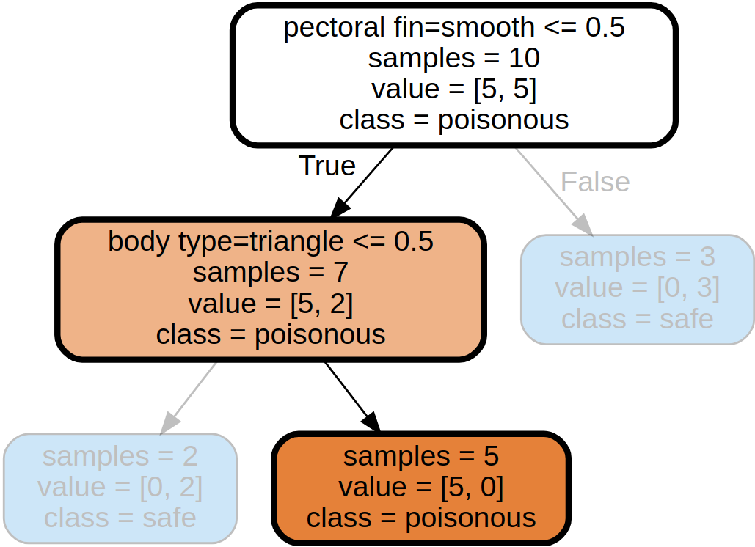
Test on new fish
Link to fish demo video

Slide 39
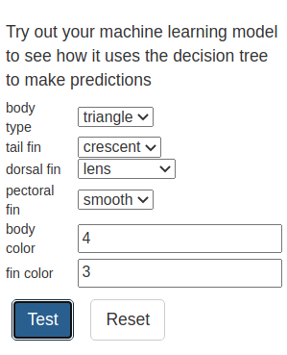
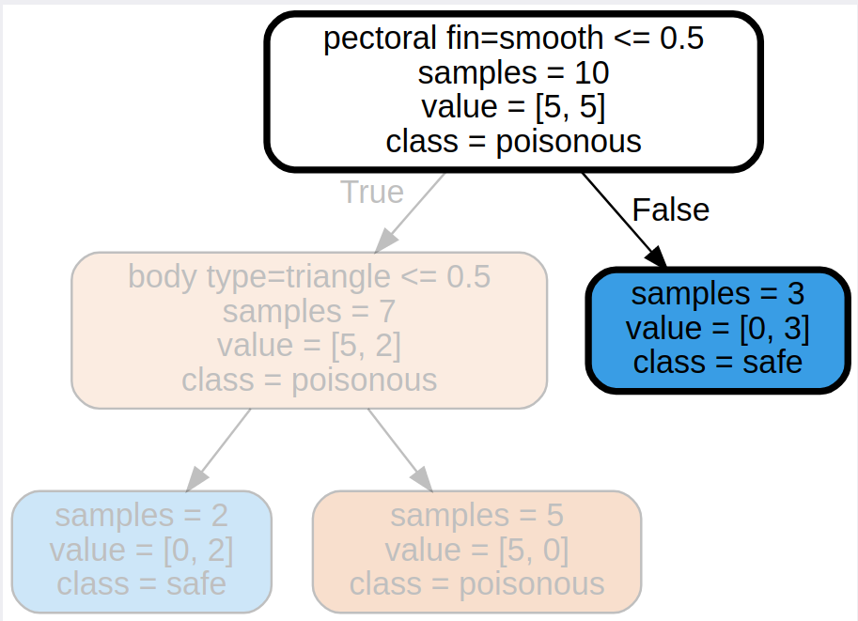
Test on new fish

Slide 40
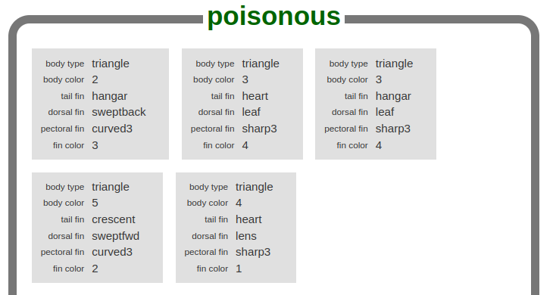
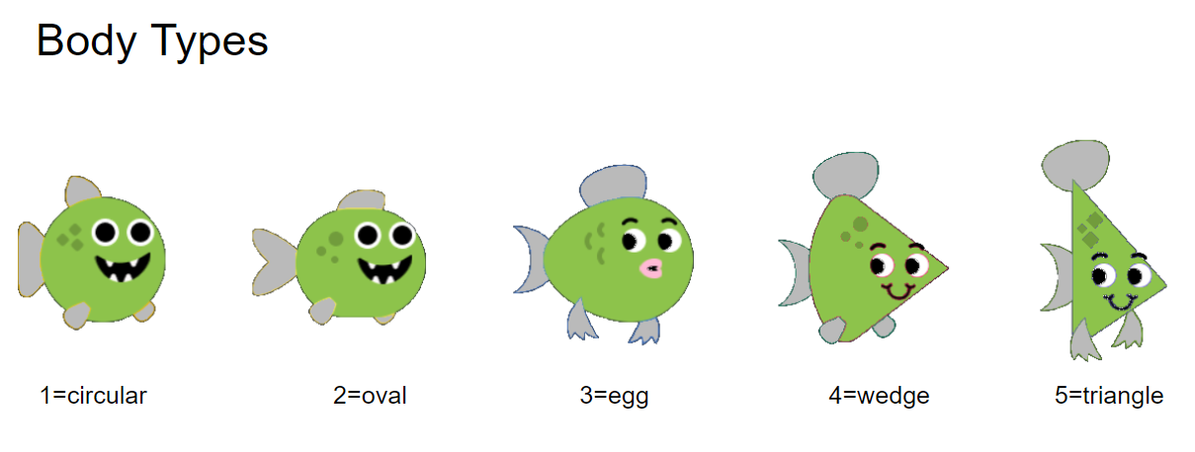
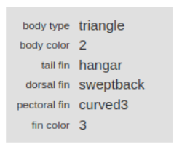
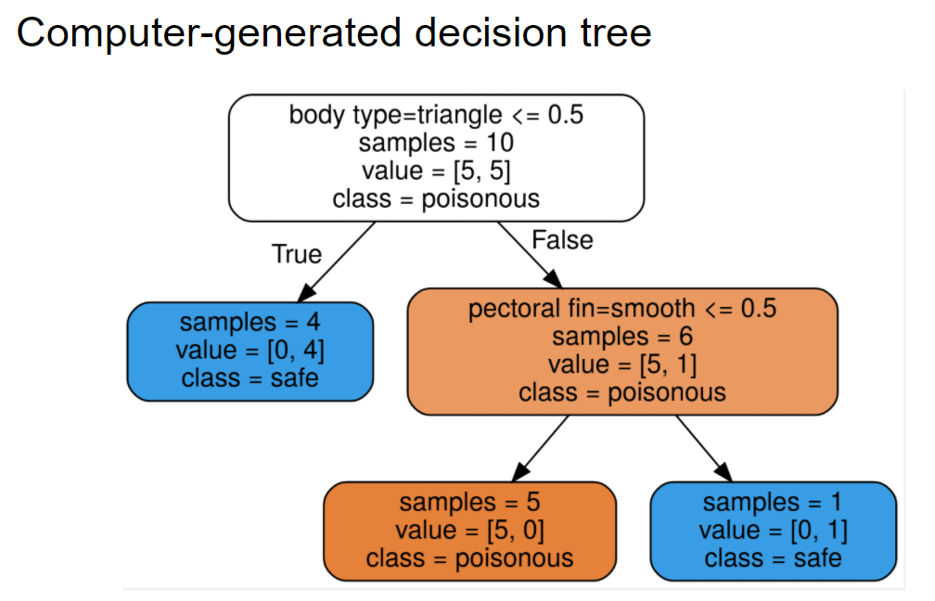
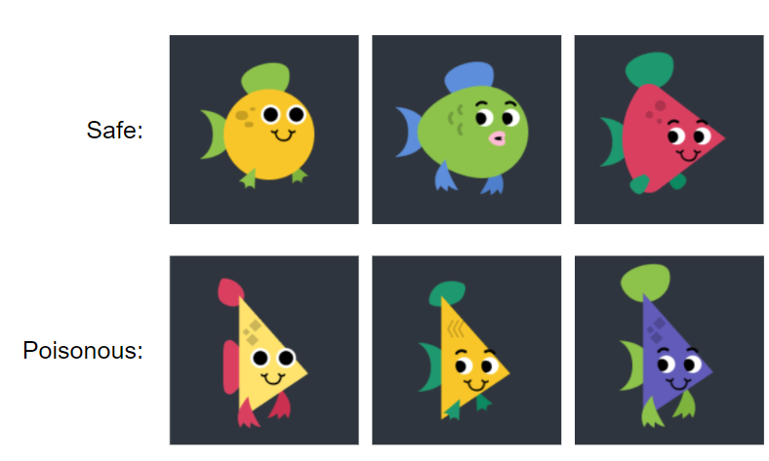

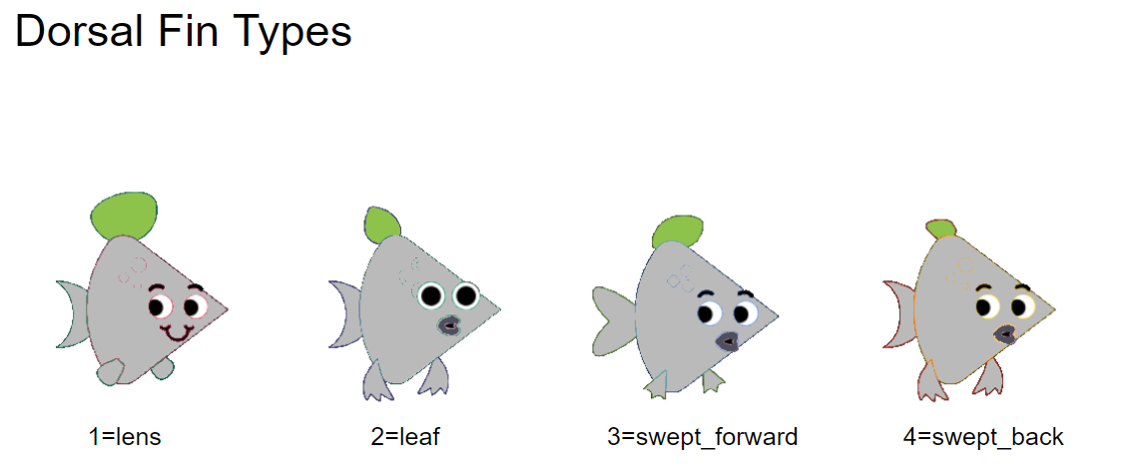
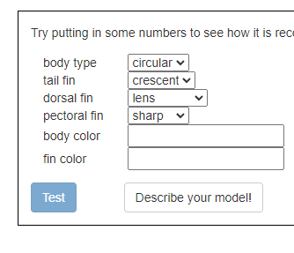
The Machine Learning Pipeline
Collect your data
Design a feature set
Code your data using the feature set
Label your data
(assign each item to a class)
Train a classifier
Test the model

Slide 41
The Machine Learning Pipeline
Collect your data
Design a feature set
Code your data using the feature set you designed
Label your data (assign each item to a class)
Train a classifier on your data so it predicts the class from the features
Is your classifier good at its job? How can we know?
Create some test data that were not used in training
Run the test data through the classifier and see how often it outputs the correct class

Slide 42
A New Machine Learning Problem

Slide 43
Predicting Patients At Risk for Angelique’s Disease
Did Not Develop the Disease
Did Develop the Disease
Patient ID | Enzyme test | Nerve test
AXQJ | 3.1 | 85
FWBR | 4.2 | 71
POMZ | 3.5 | 91
RJHW | 8.5 | 24
QKLE | 9.6 | 17
GSIB | 7.9 | 19
Patient ID | Enzyme test | Nerve test
MOZR | 4.2 | 17
LAKS | 4.1 | 24
EBJF | 3.1 | 18
QXPW | 9.6 | 71
HMWV | 8.7 | 82
IRTN | 7.9 | 91

Slide 44
Setting Up the Project in MachineLearningForKids
Link to disease demo video
New project, recognizing numbers
Add value: Enzyme test (numbers)
Add value: Nerve test (numbers)
Create
Add new label: no_disease
  Enter patient data
Add new label: got_disease
  Enter patient data
Back to project, Learn & Test
Train new machine learning model
Describe your model
Notes:
Make sure for a skill perspective that students have been able to create their own thing or at least used all the key features of ML4K

Slide 45
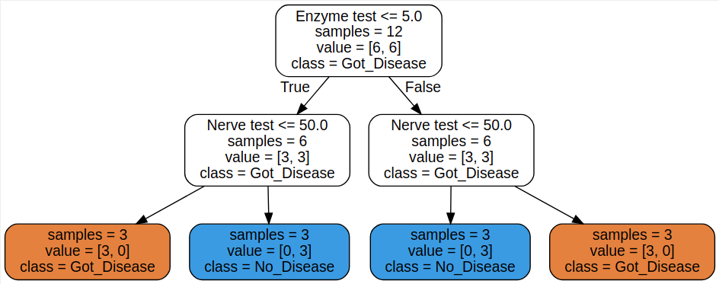
The Simplest Solution for Angelique’s Disease Prediction

Slide 46
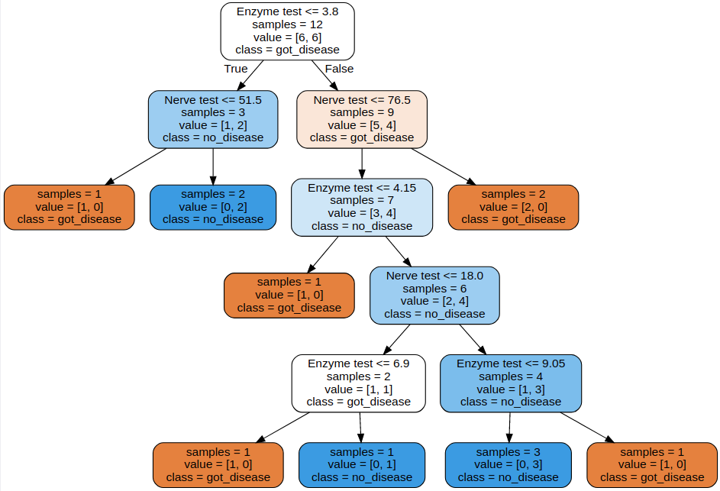
Typical Solution Produced by ML4K Learning Algorithm
The learning algorithm is not as smart as we are. Its decision tree correctly classifies all the training data but is more complex than necessary.

Slide 47
Dealing with outliers
Class “A” is mostly orange ovals.
Class “B” is mostly blue/green triangles.
Which feature is a more reliable predictor of class: color or shape?
Decision tree learning algorithms use statistics to pick the most reliable and informative features to use.
Class “A”
Class “B”
Sources of outliers:
The data may contain errors:
  Measurement error when the data were collected.
  Transcription error when the collected data were recorded.
The feature space may be inadequate: color and shape aren’t enough.
  Perhaps some other feature, such as size, partially determines class membership.
The real world is always somewhat noisy and random.
Notes:
When shape and color conflict, large size means trust the color; small size means trust the shape.
If we can only pick one feature, we could use shape.
We can’t tell if the outliers are noise or if we need to accommodate the irregularities.

Slide 48
Titanic Survival Dataset
Notes:
Teacher preparation

Slide 49
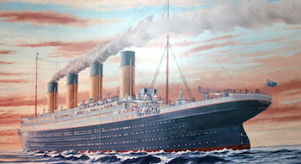
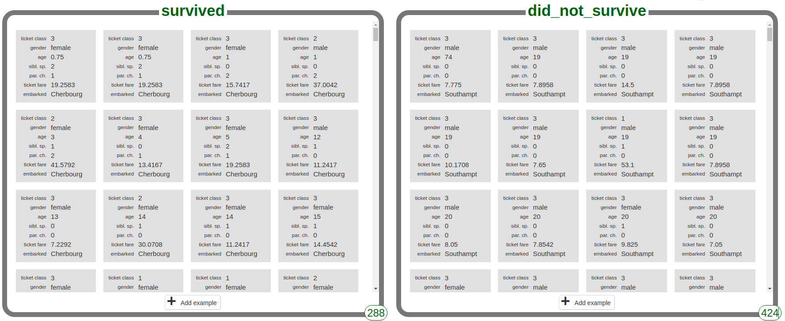
Who survived the Titanic?
https://machinelearningforkids.co.uk
Features: ticket class, gender, age, traveling with siblings/spouse/parents/children,
ticket fare, point of embarkation.
Notes:
We know specific things about the people (top of the slide)
We are only looking at a small part of the dataset see the oval at the bottom right corner

Slide 50



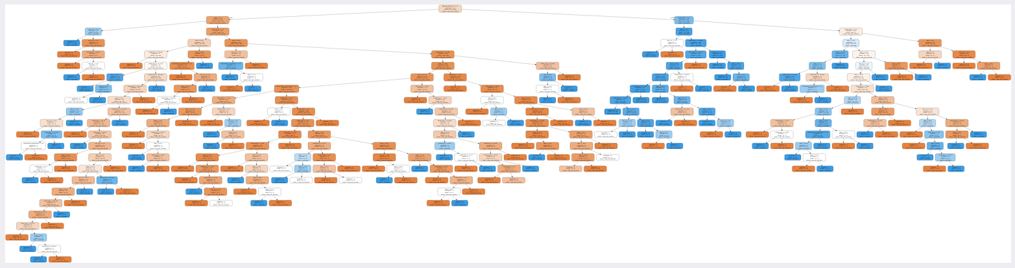
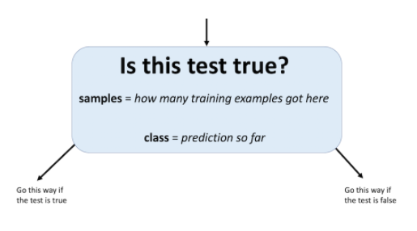
Titanic decision tree
True
False
Notes:
This a more realistic dataset. More features, more data. It would be really hard for a human to do this.
This tree is smart and it does complicated statistical calculations to make good decisions and build a complicated tree.
Gender=female <=0.5 (is gender = female false)
Why is this tree slightly orange. Most of the people did not survive. We already know that approx ⅔ did not survive and ⅓ are in the.
Gender is the most predictive feature of survival. Females were put on the life boats.
This tells us that the gender feature is a pretty strong predictor because the children nods are strongly orange or blue.
Left -hand side are the male passenger. However there are several survivors, males in first class and male children.

Slide 51
Practical Uses of Decision Trees
Assessing loan applications: deciding who gets a mortgage
Detecting fraud in credit card transactions
Medical decision making
  Which patients are at higher risk and need special monitoring
  Which patients are good candidates for a specialized treatment

